Slide 1
Context Free Grammar
In CFG, every production is in the form of A→α,
where A is a Variable and α is the combination of variables and terminals or empty symbol

Slide 2
The Language of CFG
The language generated (defined, derived, produced) by a CFG ‘G’ is the set of all strings of terminals that can be produced from the start symbol S using the productions as substitutions.
A language generated by a CFG is called a Context Free Language (CFL) and it is denoted by L(G)

Slide 3
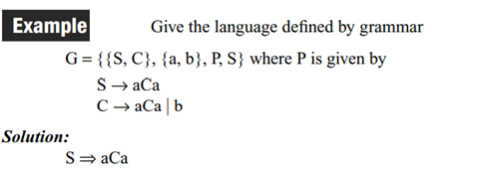
The Language of CFG : Example

Slide 4
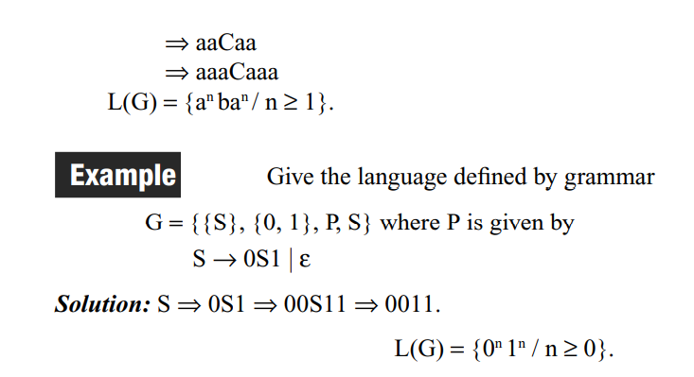
The Language of CFG : Example

Slide 5
Context Free Grammar : Example
Construct the CFG for the Language {0^{n} 1^{n} / n>=0}
Solution:
productions are S→0S1 / є
CFG G =({S, {0,1}, {S→0S1, S→ є}, S)
Example Derivation:
1. S=>0S1 2. S=> є belongs to given Language (n=0)
=> 00S11
=>000S111
=>000 є111
=>000111 belongs to given language (n=3)

Slide 6
Context Free Grammar : Example
2. Construct the CFG for the Language {0^{n} 1^{n} / n>=1}
Solution:
productions are S→0S1 / 01
CFG G =({S, {0,1}, {S→0S1, S→ є}, S)
Example Derivation:
1. S=>0S1 2. S=>01 belongs to given Language (n=1)
=> 00S11
=>000S111
=>000 01111
=>00001111 belongs to given Language (n=4)

Slide 7
Context Free Grammar : Exercise
3. Construct the CFG for the Language {1^{n} 0^{n} / n>=1}
4. Construct the CFG for equal number of a’s and b’s over the alphabet {a,b}. Test the string aabbba.
Solution:
S→SS
S→ є
S→aSb
S→bSa
Test the string aabbba:
S=>SS
S=>aSbS (rule 3)
S=>aaSbbS (rule 3)
S=>aa є bb S(rule 2)
S=>aabbbSa (rule 4)
S=>aabbb є a=>aabbba

Slide 8
Context Free Grammar : Exercise
5. Construct the CFG for the Language {0^{n} 1^{n+1} / n>=0}. Test the string 00111 with derivations
Solution:
S→A1
A→0A1
A→ є
CFG G=({S,A}, {0,1}, {S→A1,A→0A1,A→ є}
Testing string : 00111
S=>A1 (rule1)
S=>0A11 ( rule 2)
S=>00A111 (rule 2)
S=>00 є111 (rule 3)
S=>00111 € L(G). Thus, string is accepted with the grammar G.

Slide 9
Context Free Grammar (CFG): Example
Construct a CFG for palindromes over the alphabet {0,1}
Solution:
S→є
S→0
S→1
S→0S0
S→1S1
Grammar G=(V,T,P,S)
Where V={S}
T={0,1}
P= {S→є, S→0, S→1, S→0S0, S→1S1}
S= S

Slide 10
Context Free Grammar (CFG): Example

Slide 11
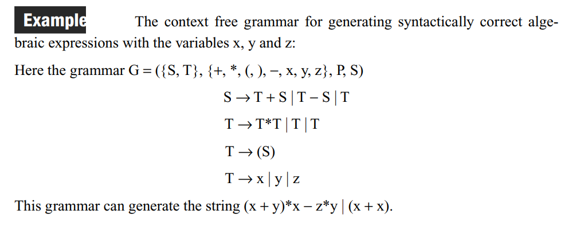
Context Free Grammar (CFG): Example

Slide 12
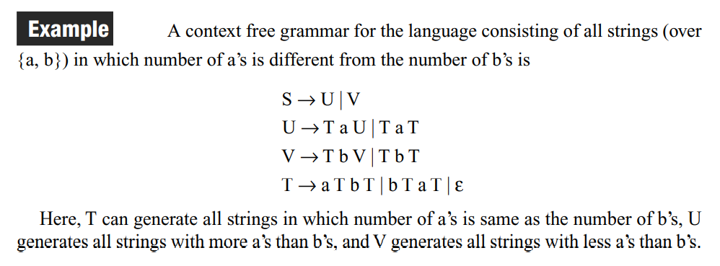
Context Free Grammar (CFG): Example
Construct CFG for L={a^{n} b^{m} / n is not equal to m}
or

Slide 13
Derivations – Left most derivations and Right Most Derivations
Derivation
“The process of deriving a string is called as derivation.”
A derivation uses the productions of a grammar to replace non terminals (or variables) until there are only terminals left.
A single step derivation shown by the following symbol
=>
Multi step (recursive step) derivation of the string shown by following symbol $\underset{⇒}{∗}$

Slide 14
Derivations – Left most derivations and Right Most Derivations

Slide 15
Derivations – Left most derivations and Right Most Derivations
Leftmost Derivation
The process of deriving a string by expanding the leftmost non-terminal at each step is called as leftmost derivation.
The geometrical representation of leftmost derivation is called as a leftmost derivation tree.

Slide 16
Derivations – Left most derivations and Right Most Derivations
Consider the following grammar-
S → aB / bA
S → aS / bAA / a
B → bS / aBB / b
(Unambiguous Grammar)
Let us consider a string w = aaabbabbba
Leftmost Derivation-
S => aB
=>aaBB (Using B → aBB)
=> aaaBBB (Using B → aBB)
=> aaabBB (Using B → b)
=> aaabbB (Using B → b)
=> aaabbaBB (Using B → aBB)
=> aaabbabB (Using B → b)
=> aaabbabbS (Using B → bS)
=> aaabbabbbA (Using S → bA)
=> aaabbabbba (Using A → a)

Slide 17
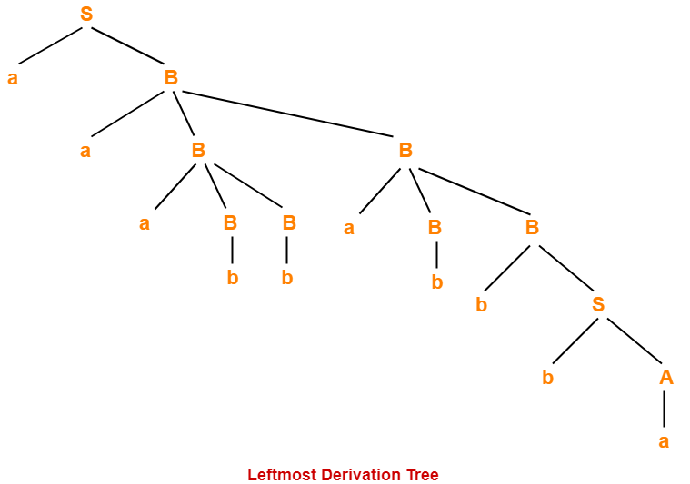
Derivations – Left most derivations and Right Most Derivations
Leftmost Derivation-
S => aB
=>aaBB (Using B → aBB)
=> aaaBBB (Using B → aBB)
=> aaabBB (Using B → b)
=> aaabbB (Using B → b)
=> aaabbaBB (Using B → aBB)
=> aaabbabB (Using B → b)
=> aaabbabbS (Using B → bS)
=> aaabbabbbA (Using S → bA)
=> aaabbabbba (Using A → a)

Slide 18
Derivations – Left most derivations and Right Most Derivations
Rightmost Derivation
The process of deriving a string by expanding the rightmost non-terminal at each step is called as rightmost derivation.
The geometrical representation of leftmost derivation is called as a rightmost derivation tree.

Slide 19
Derivations – Left most derivations and Right Most Derivations
Consider the following grammar-
S → aB / bA
S → aS / bAA / a
B → bS / aBB / b
(Unambiguous Grammar)
Let us consider a string w = aaabbabbba
Rightmost Derivation-
S => aB
=> aaBB (Using B → aBB)
=> aaBaBB (Using B → aBB)
=> aaBaBbS (Using B → bS)
=>aaBaBbbA (Using S → bA)
=> aaBaBbba (Using A → a)
=> aaBabbba (Using B → b)
=> aaaBBabbba (Using B → aBB)
=>aaaBbabbba (Using B → b)
=> aaabbabbba (Using B → b)

Slide 20
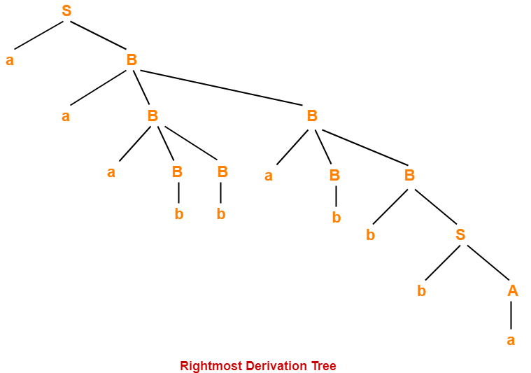
Derivations – Left most derivations and Right Most Derivations
Rightmost Derivation-
S => aB
=> aaBB (Using B → aBB)
=> aaBaBB (Using B → aBB)
=> aaBaBbS (Using B → bS)
=>aaBaBbbA (Using S → bA)
=> aaBaBbba (Using A → a)
=> aaBabbba (Using B → b)
=> aaaBBabbba (Using B → aBB)
=>aaaBbabbba (Using B → b)
=> aaabbabbba (Using B → b)

Slide 21
Derivations – Left most derivations and Right Most Derivations

Slide 22
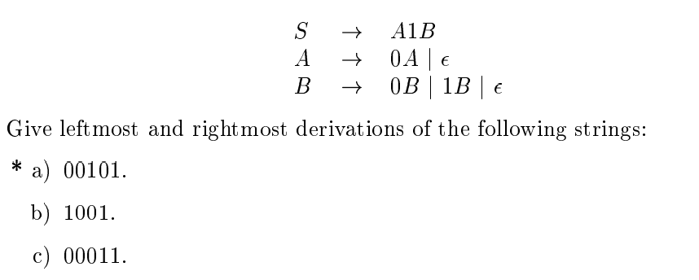
LMD and RMD :Exercise

Slide 23
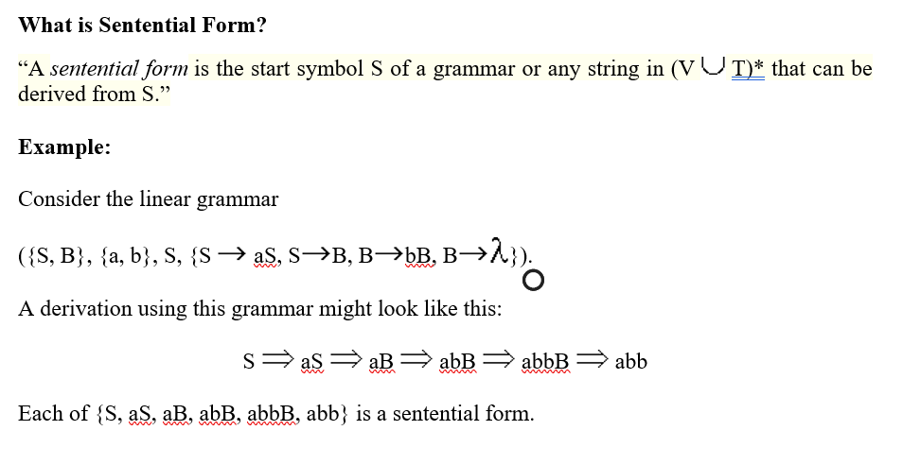
Sentential Form

Slide 24
Parse Tree or Derivation Tree Construction
Derivation tree is a graphical representation for the derivation of the given production rules for a given CFG.
It is the simple way to show how the derivation can be done to obtain some string from a given set of production rules. The derivation tree is also called a parse tree.

Slide 25
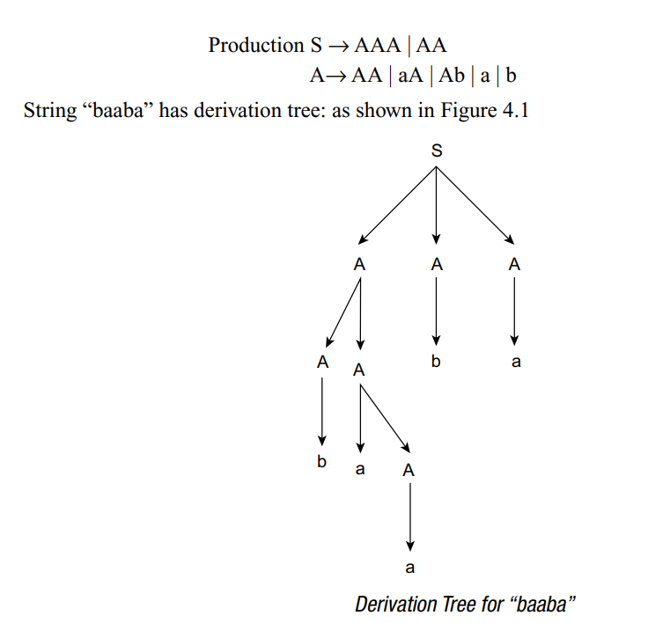
Example

Slide 26
Yield
What is yield of the Tree?
When we concatenate the leaves of any parse tree from the left, we get a string, which is known as yield of the tree.
The yield is a terminal string. All leaves are labelled with a terminal or a є

Slide 27
Applications of CFG
Context Free Grammar (CFG) is of great practical importance. It is used for following purposes-
For defining programming languages
For parsing the program by constructing syntax tree
For translation of programming languages
For describing arithmetic expressions
For construction of compilers

Slide 28
Ambiguous Grammars
A CFG is said to ambiguous if there exists more than one derivation tree for the given input string
i.e., more than one Left Most Derivation Tree (LMDT) or Right Most Derivation Tree (RMDT)

Slide 29
Ambiguous Grammars: Example
More than LMDs for the string id+id*id , Thus this Grammar is Ambiguous

Slide 30
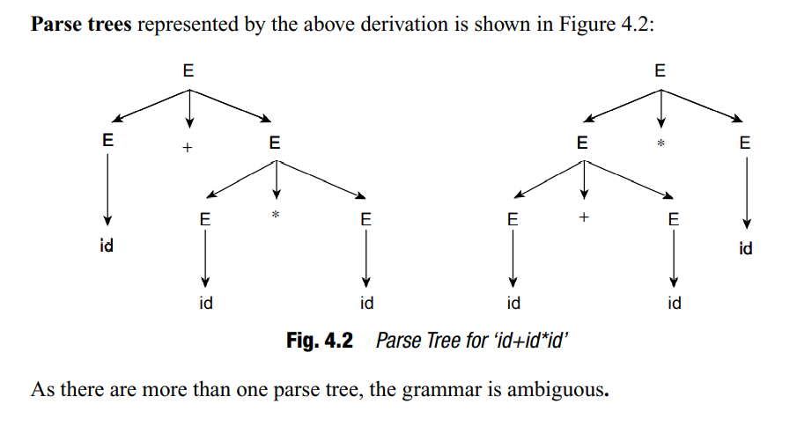
Ambiguous Grammars: Example
More than one parse trees for the string id+id*id , Thus this Grammar is Ambiguous

Slide 31
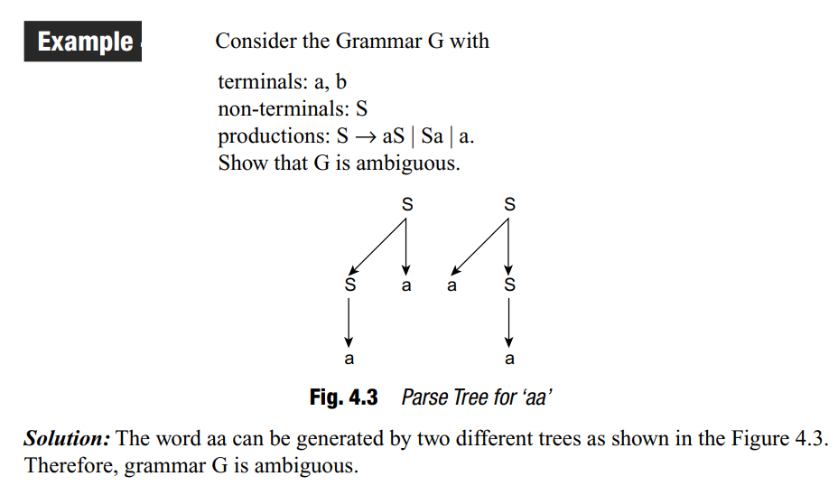
Ambiguous Grammars: Example
More than one parse trees for the string aa, Thus this Grammar is Ambiguous

Slide 32
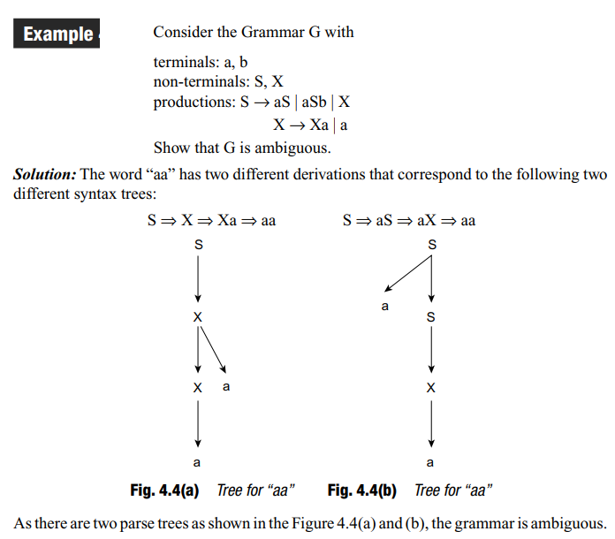
Ambiguous Grammars: Example
More than one parse trees for the string aa, Thus this Grammar is Ambiguous

Slide 33
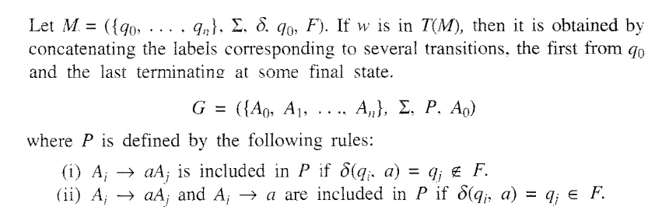
Construction of Regular Grammar T(M) Generating for a Given DFA

Slide 34
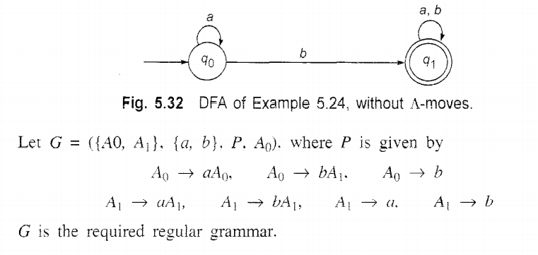
Construction of Regular Grammar T(M) Generating for a Given DFA: Example

Slide 35
Constructing a FA (Finite Automata) for given Regular Grammar (RG)
Finite Automata M = ({q0,q1,qf}, {a,b},δ, qo, {qf})

